Slide 1
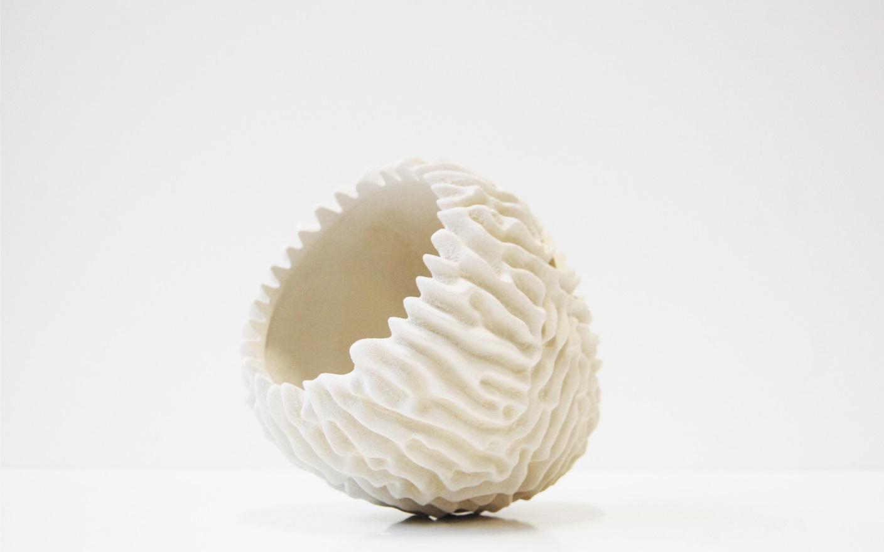


Build your own future
Eric Geboers, Slag Symposium
www.concr3de.com
@CONCR3DE

Slide 2
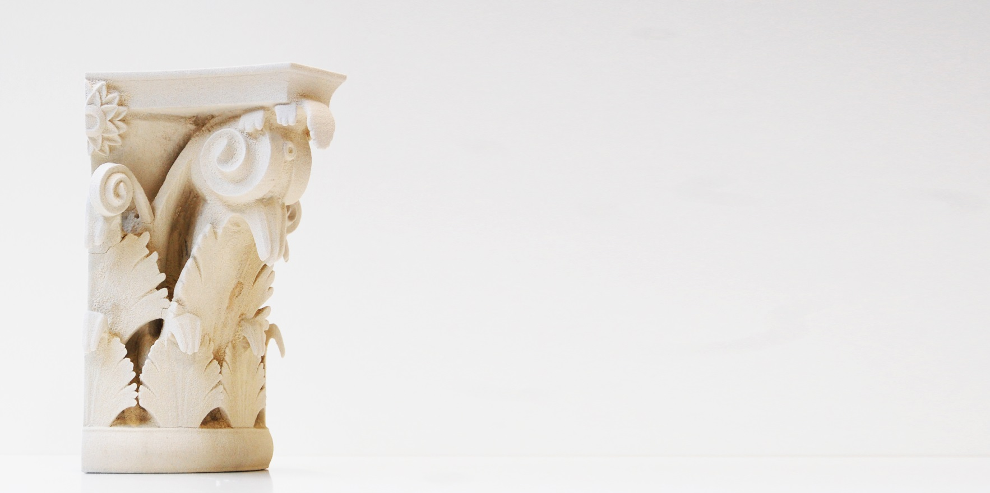
Create the future or
rebuild the past
with our affordable, sustainable and large volume stone 3d printing”

Slide 3
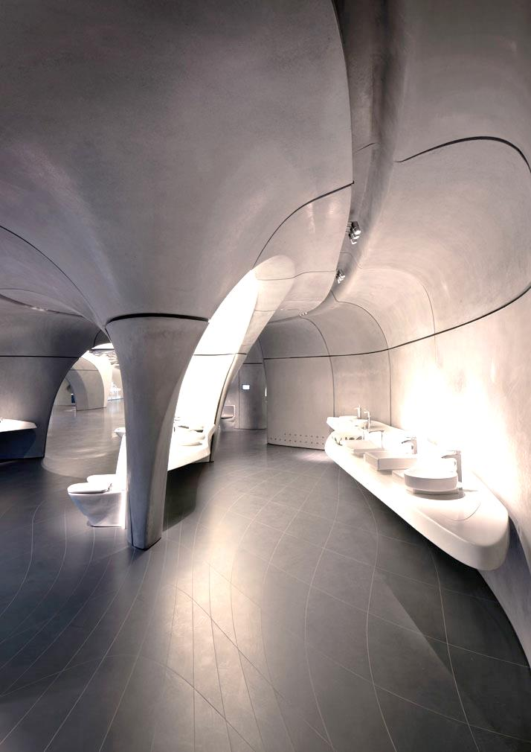
Digitization and BIM
Prefab construction
Materials circularity
Sophisticated 3d design tools
Increasing complexity
© Zaha Hadid

Slide 4
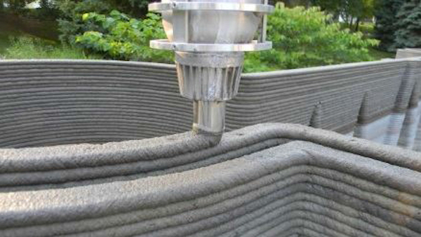
© Rudenko

Slide 5
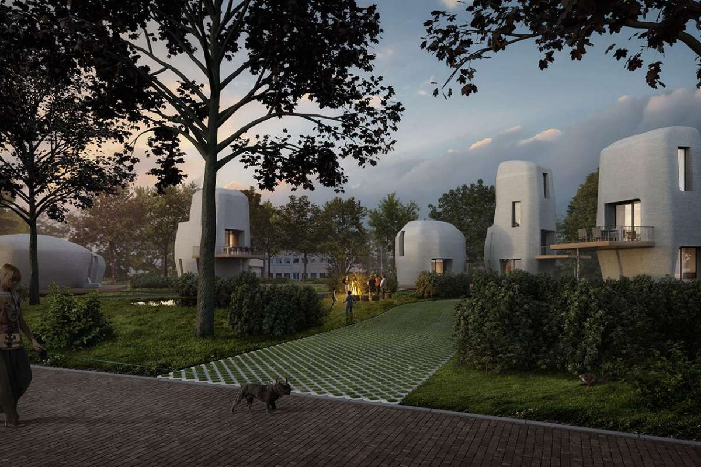

Slide 6
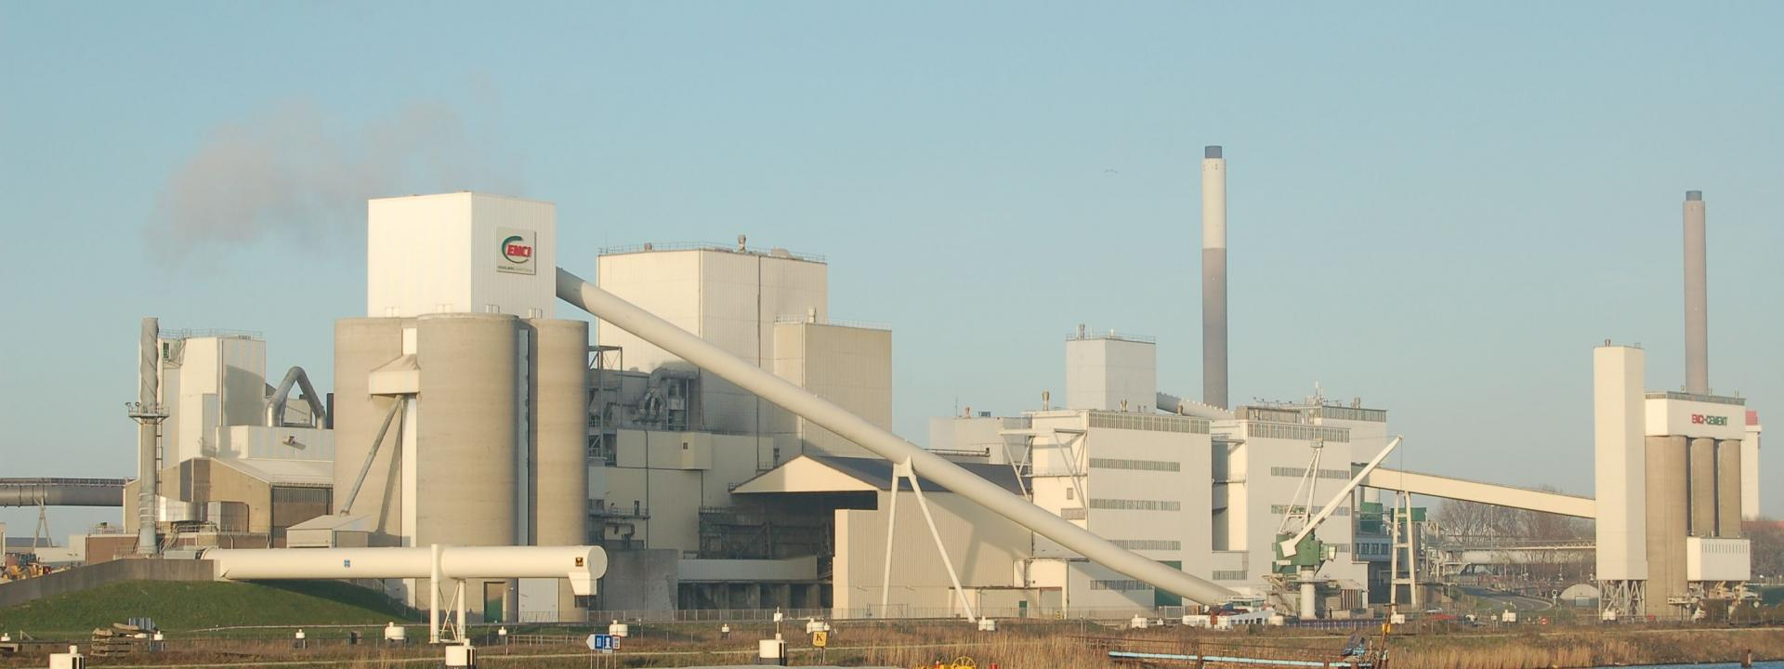
8% of worldwide co₂
3x aviation industry

Slide 7

How we see it
Use inkjet technology
Print prefab
Print high value specials (finishes)
Focus on form freedom, sustainability & performance

Slide 8
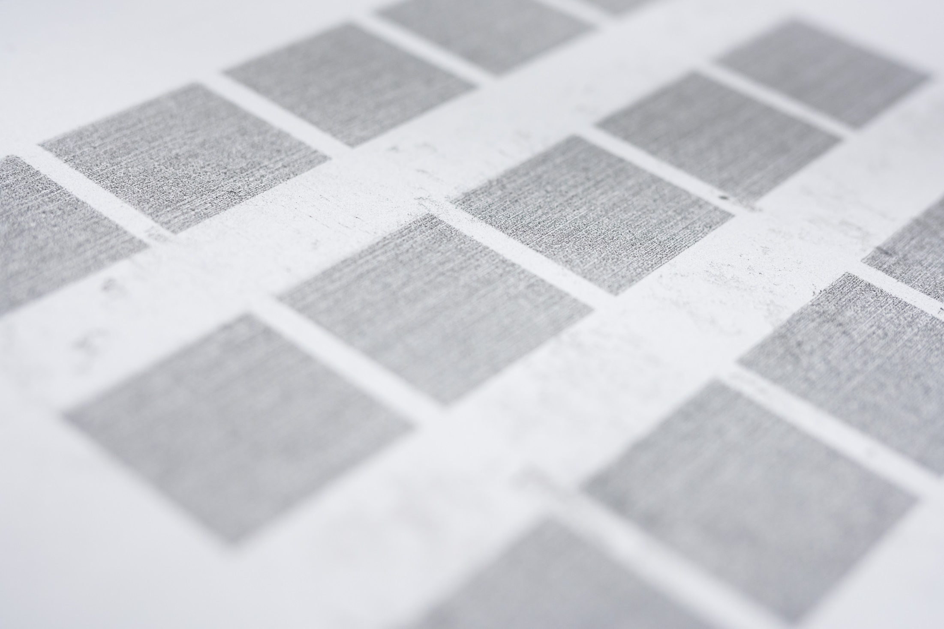
Zero waste
No OPC

Slide 9
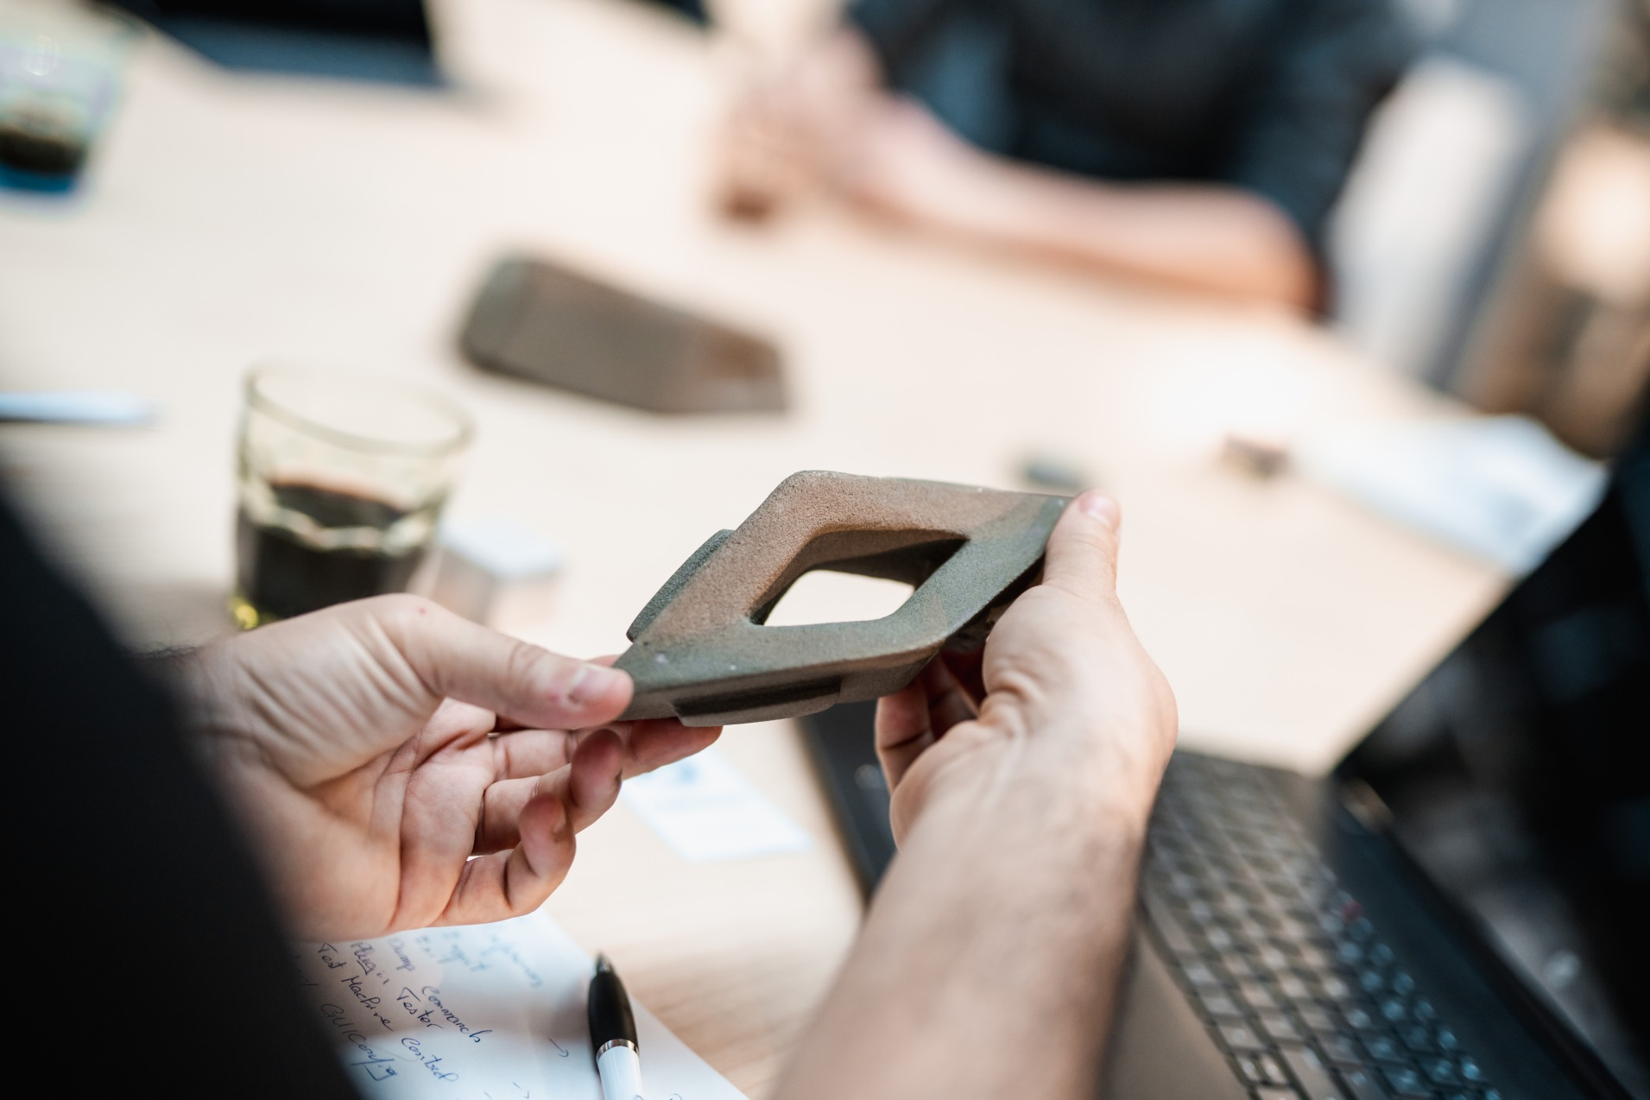
From design to reality with CONCR3DE technology.
^{This is how it works.}

Slide 10
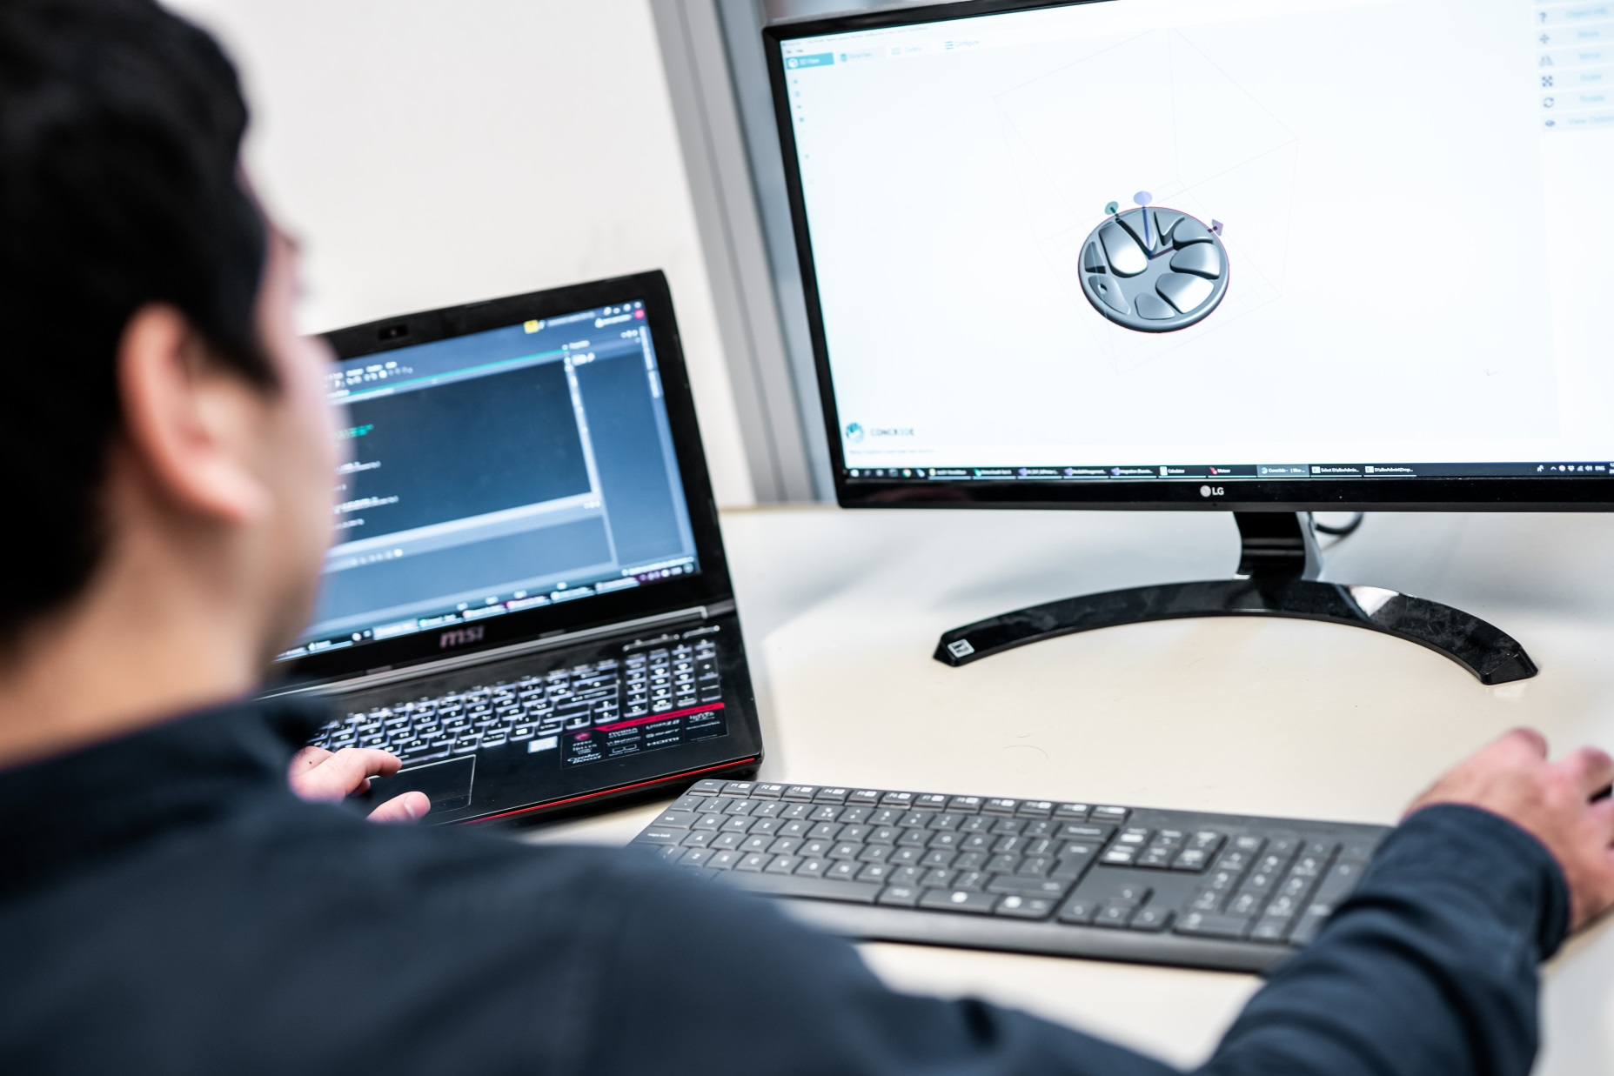
1.
Load your 3D model into NOAH, CONCR3DE’s printing software.
.
NOAH accepts any .stl, .obj or other closed mesh file, just like you’re used to.
.

Slide 11
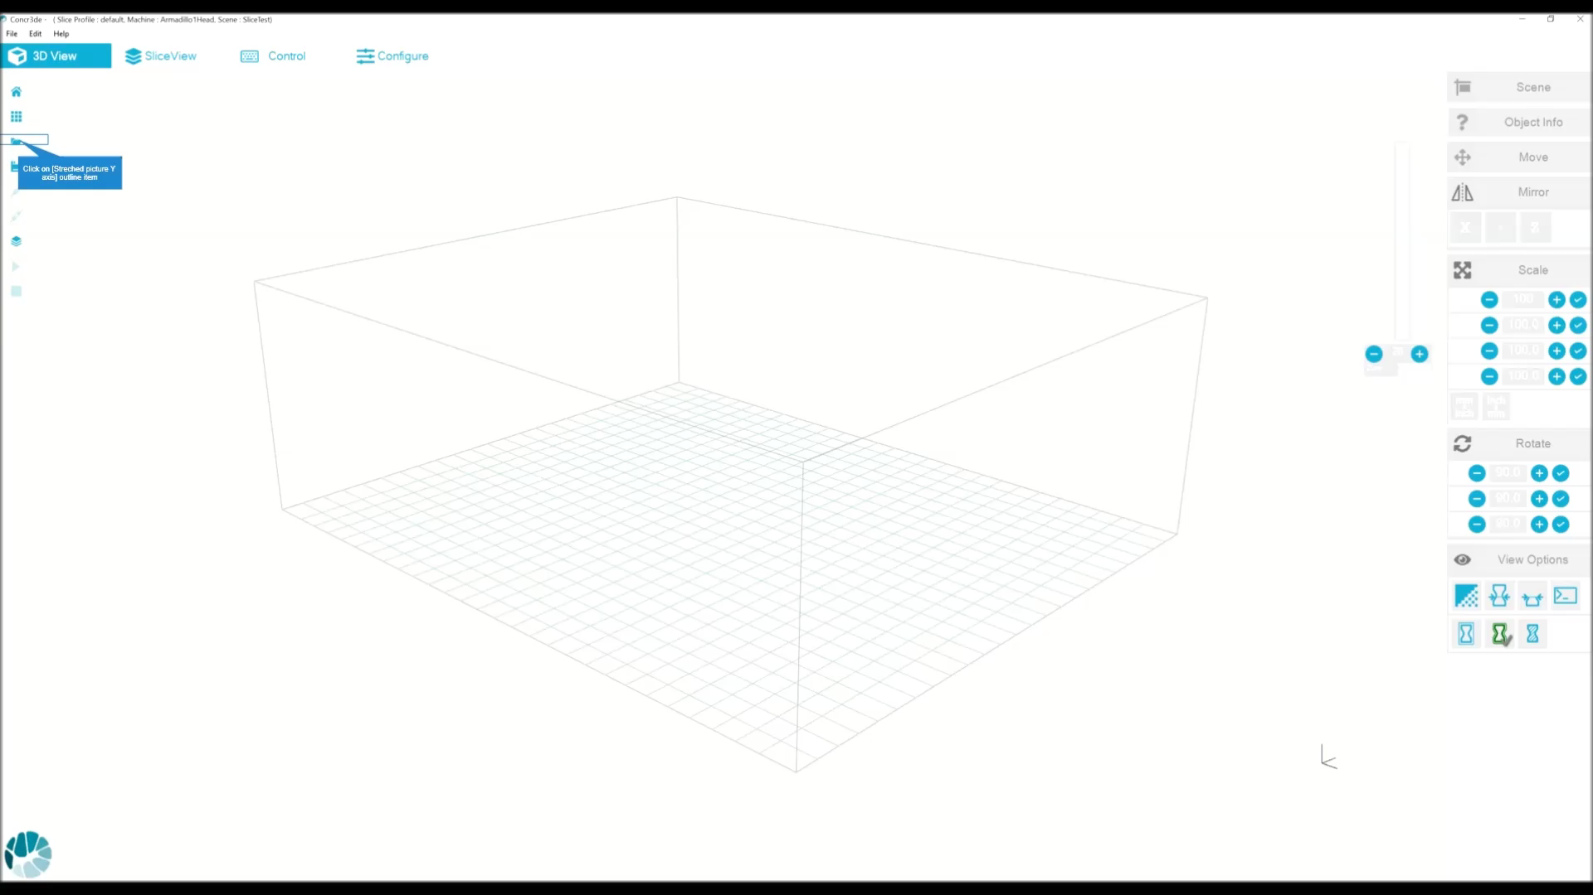
2.
NOAH allows you to print multiple models at once and modify your printing settings for the perfect result
Choose your material, slice your print with a single click and you’re ready to go!

Slide 12
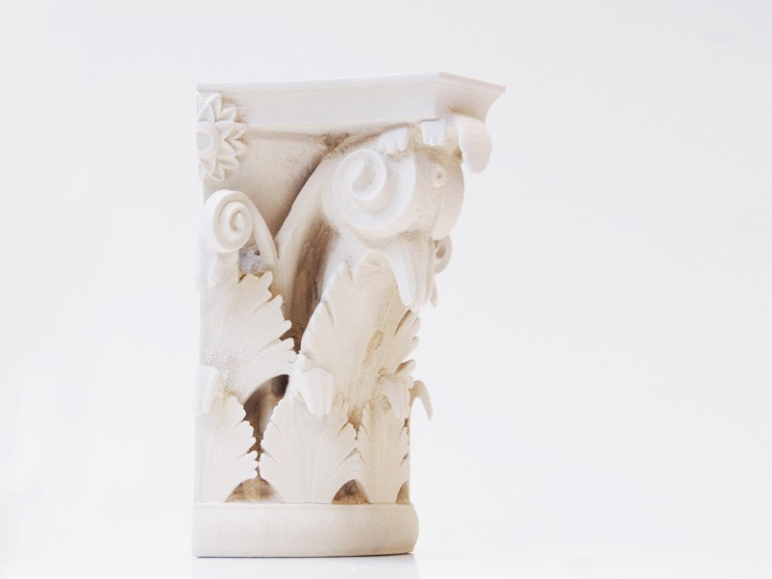

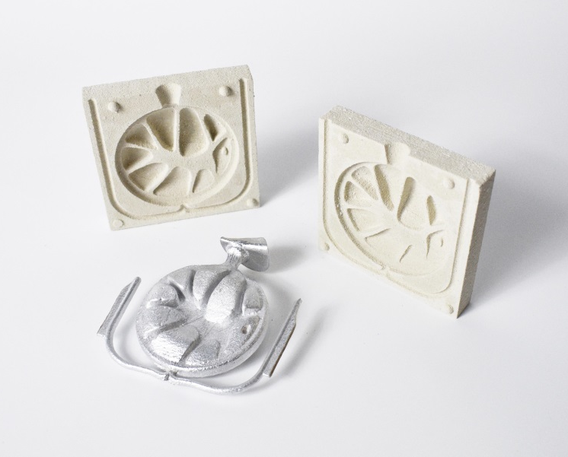
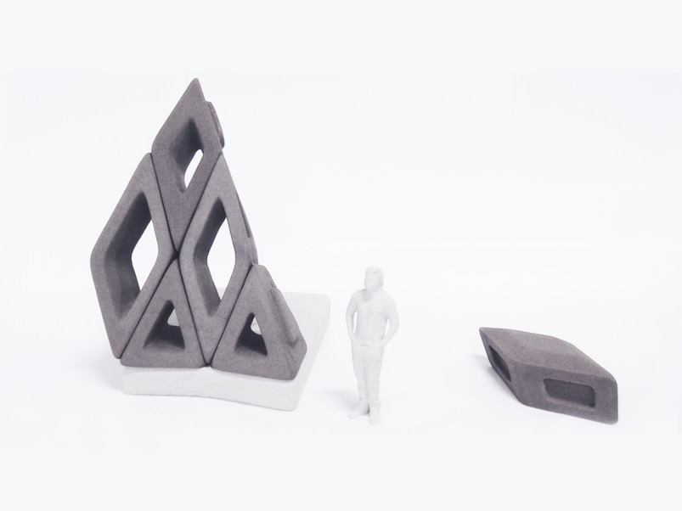
3.
Choose the perfect premixed material for your application, whether it’s architecture, restoration, metal casting or design.
Three material systems are available at launch: grey stone, white stone and foundry sand. More will be launched later on!

Slide 13
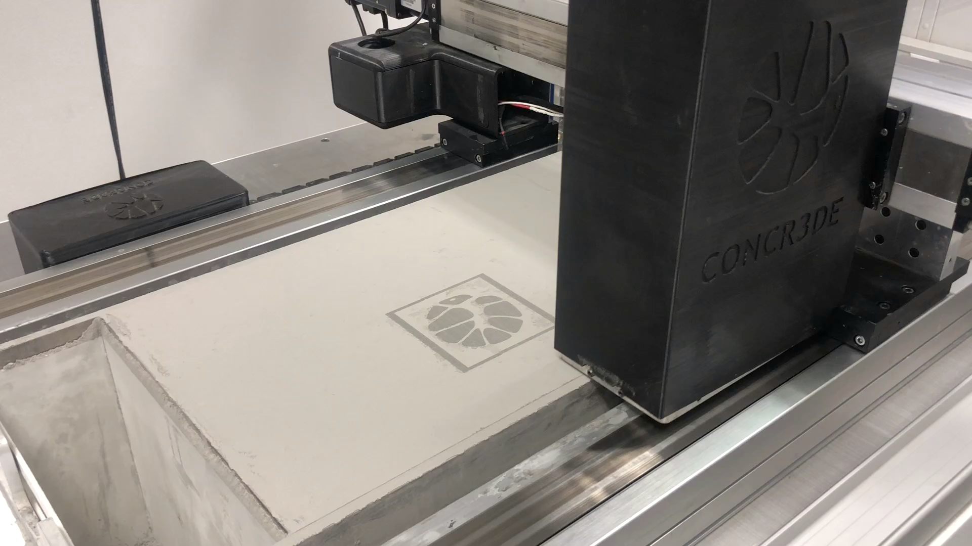
4.
^{Click print!}

Slide 14
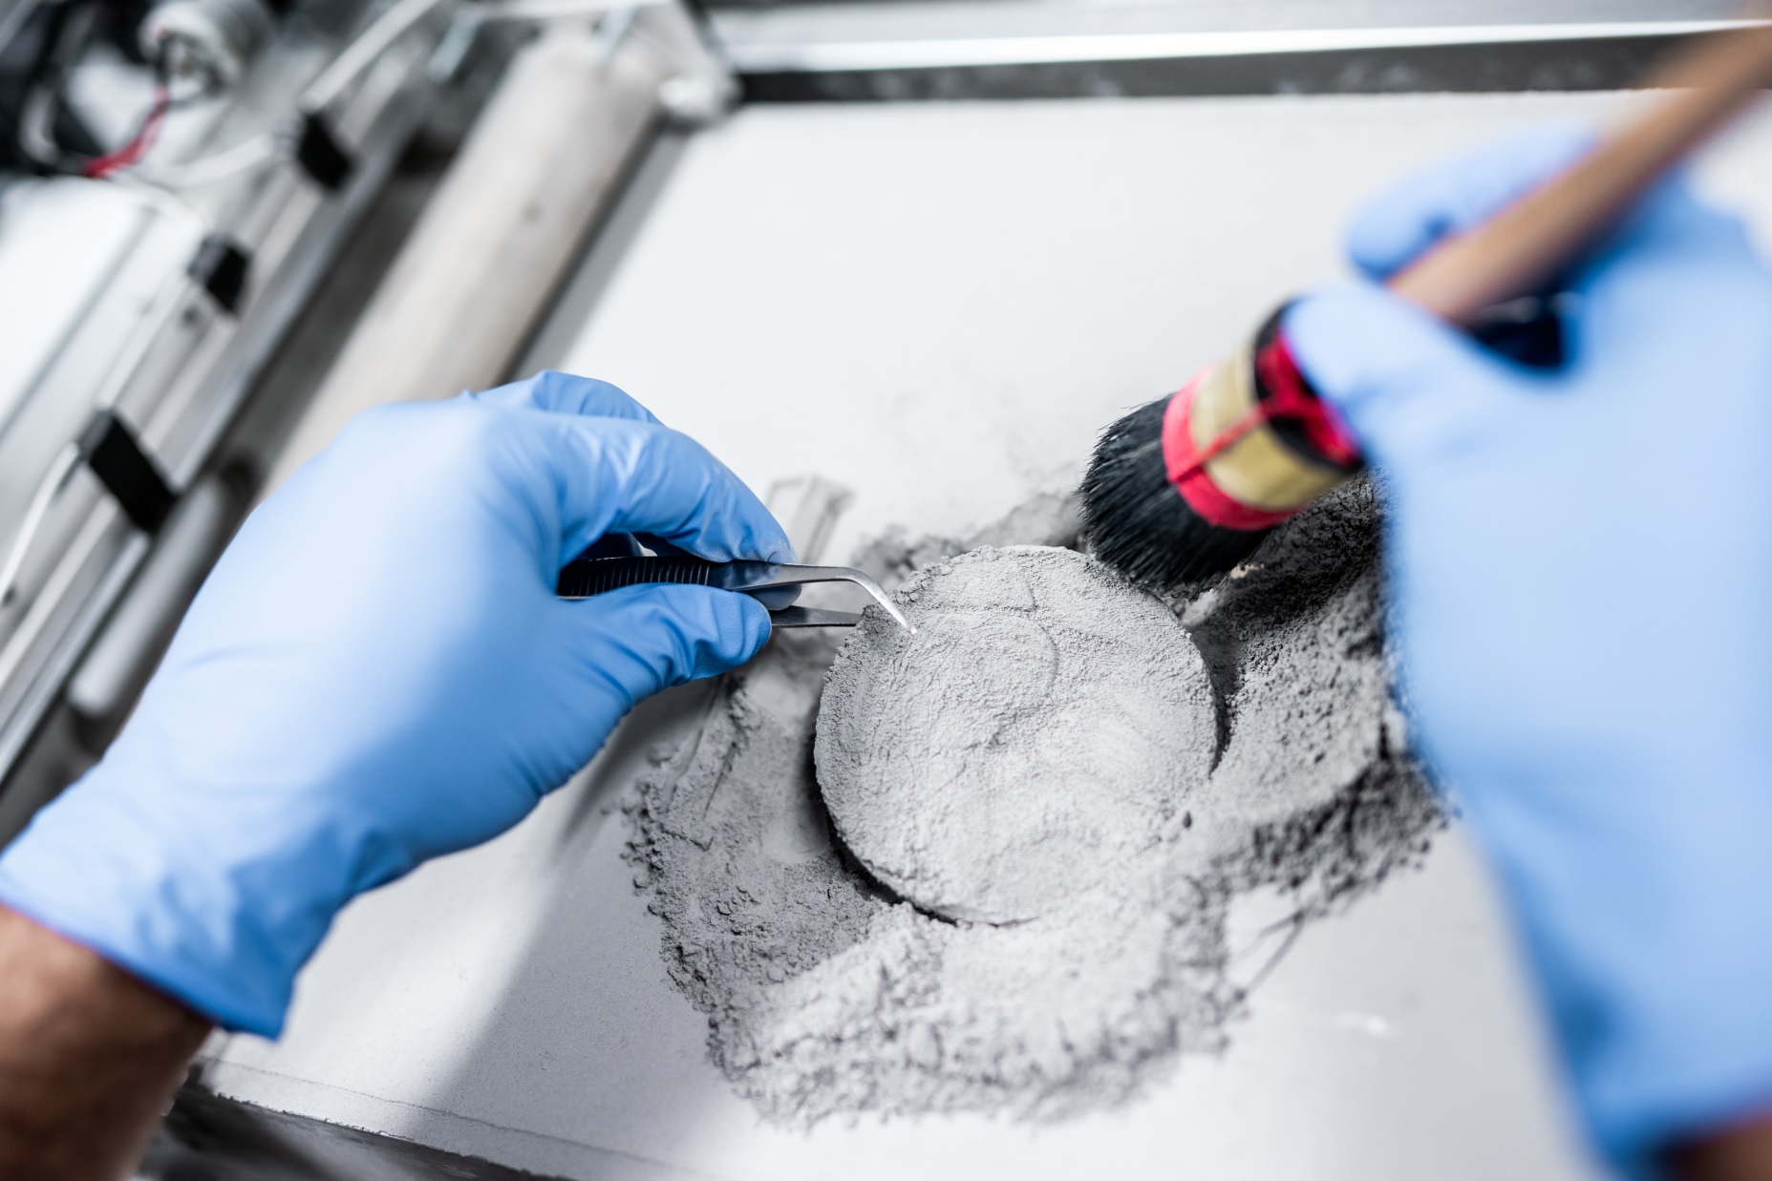
5.
Depowder your print. Just like an archeologist, you dust off the result and you’re ready to use your part..

Slide 15
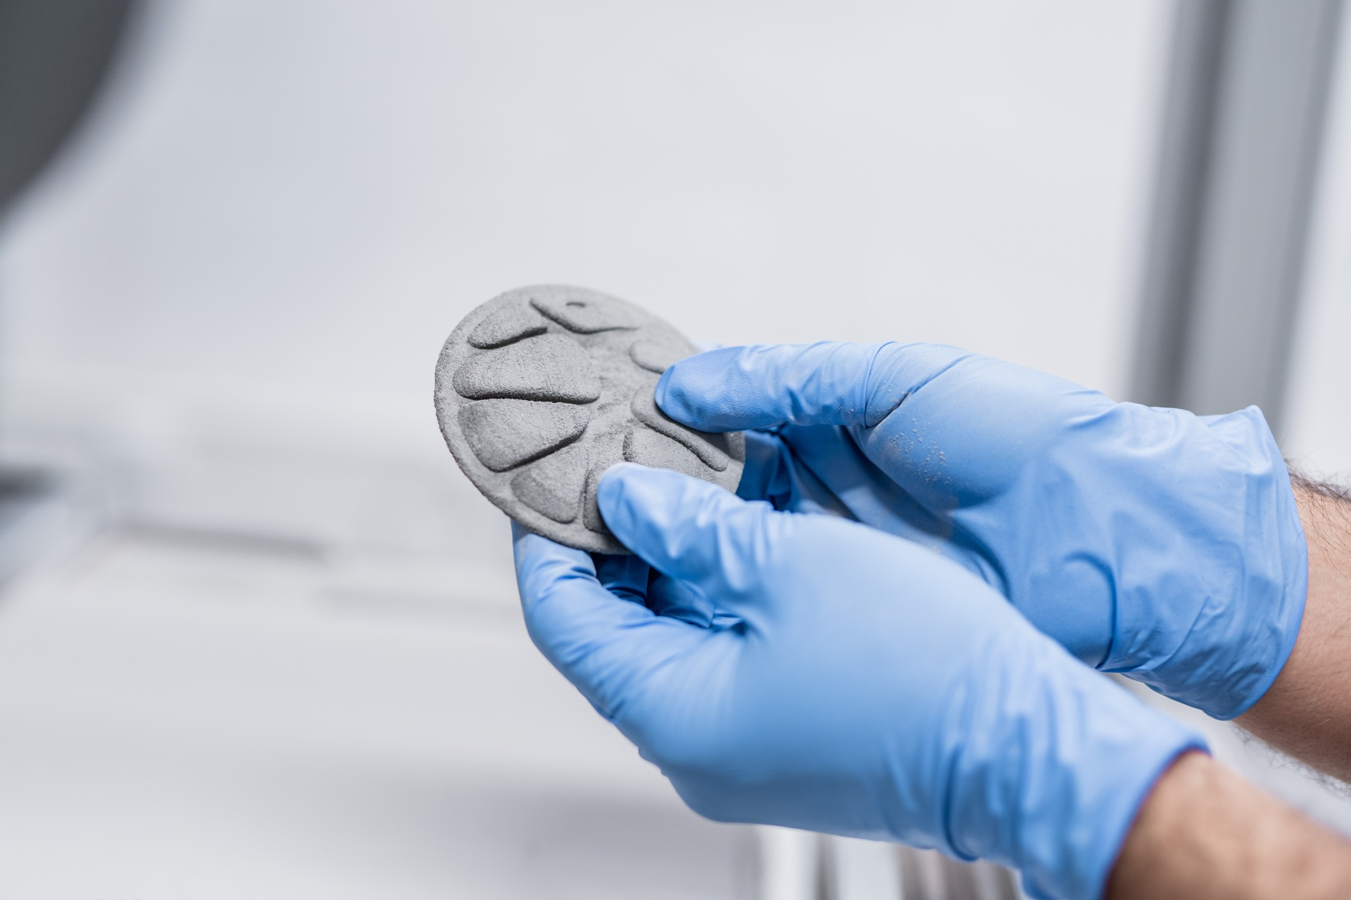
6.
No post processing is necessary. There is no waste produced in the process. All powder that is not printed can be fully recycled for new prints.
.
.

Slide 16
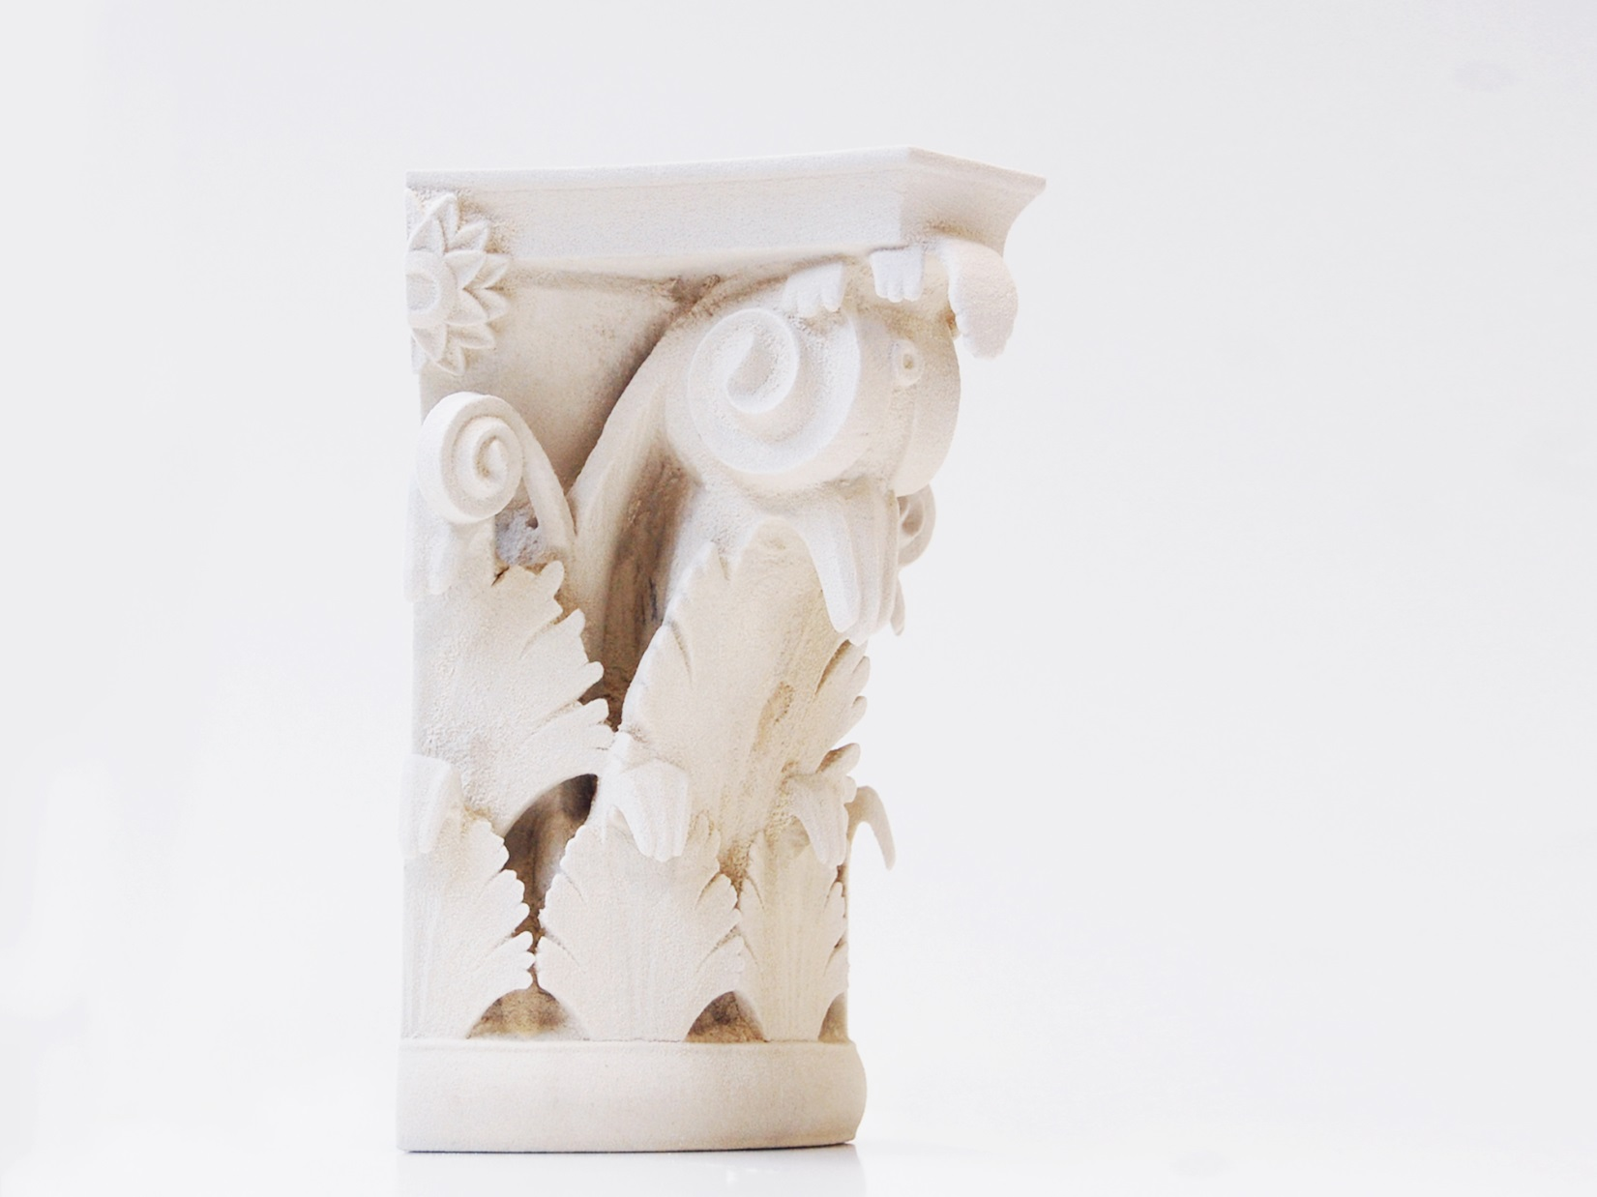
Printing time 4-5 hours
Druksterkte 20-25 MPa
Duurzaam en bestendig tegen vocht, vorst, brand, zout en zuur

Slide 17
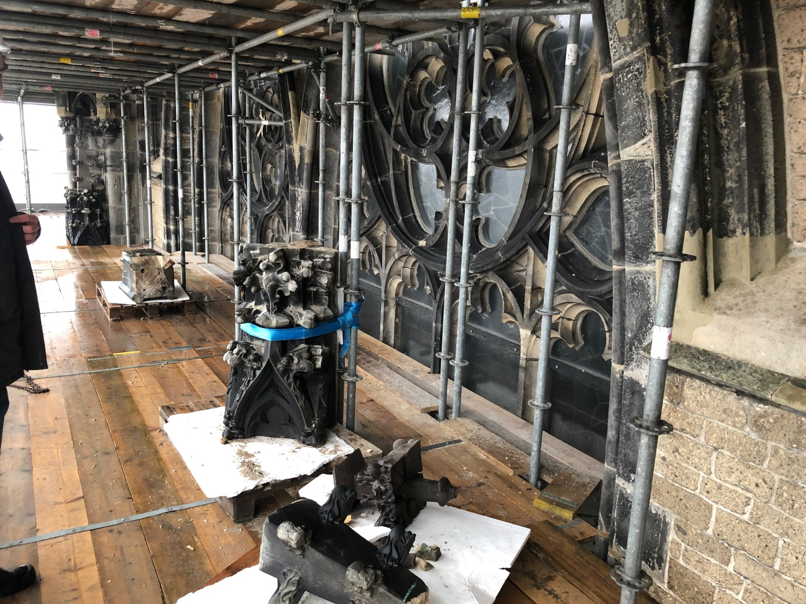

Slide 18
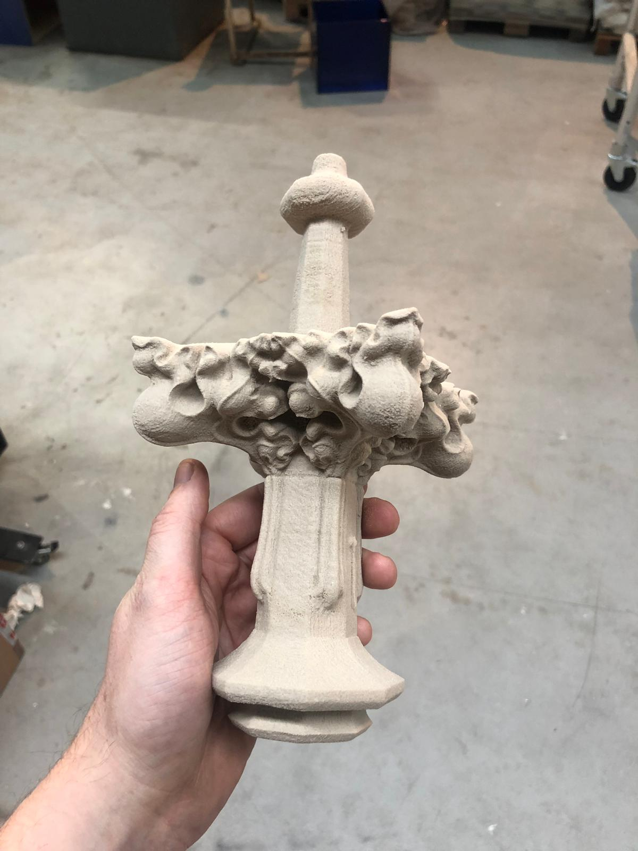
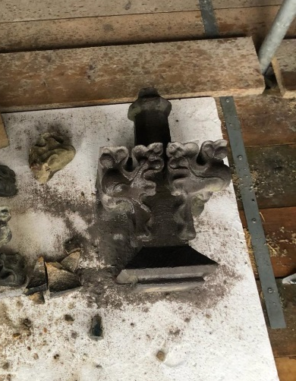

Slide 19
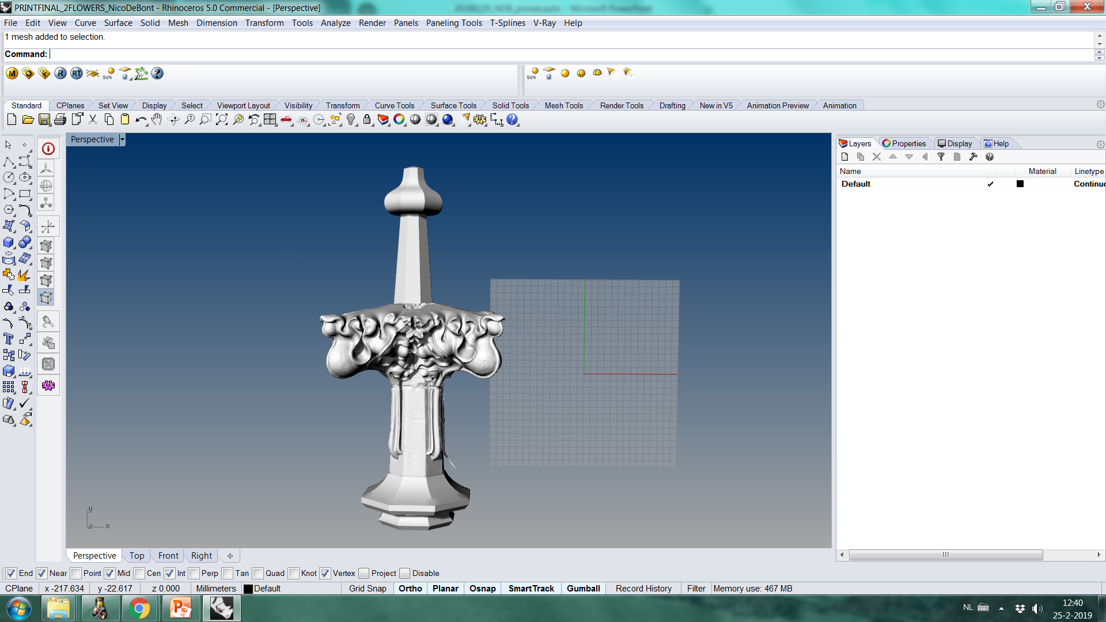
1.
Het ontvangen model van Nico de Bont
Een gesloten mesh (stl, obj) kan geprint worden.

Slide 20
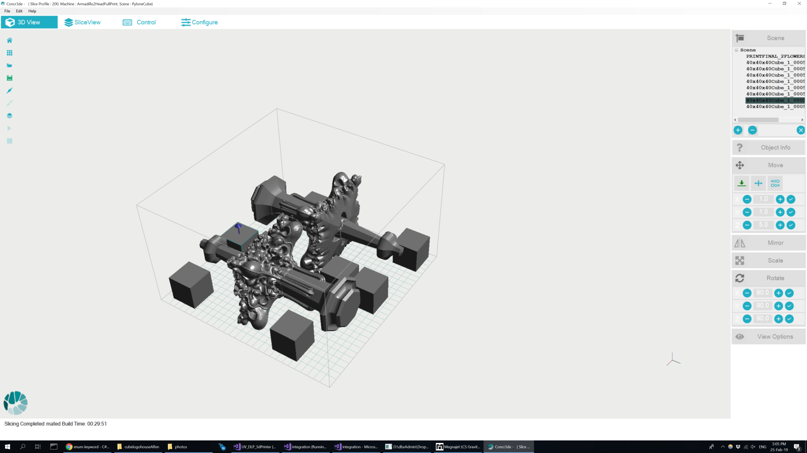
2.
We ‘slicen’ het model in plakken
In de ‘print box’ kunnen meerdere objecten tegelijkertijd geprint worden

Slide 21
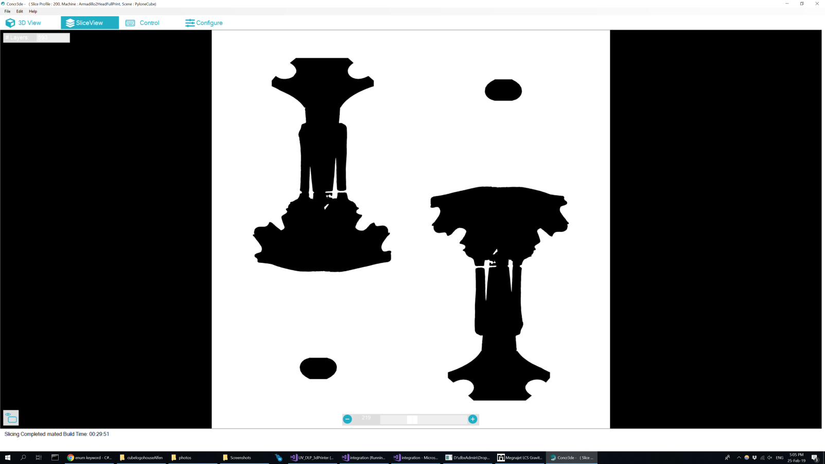
3.
We ‘slicen’ het model in plakken
In de ‘print box’ kunnen meerdere objecten tegelijkertijd geprint worden

Slide 22
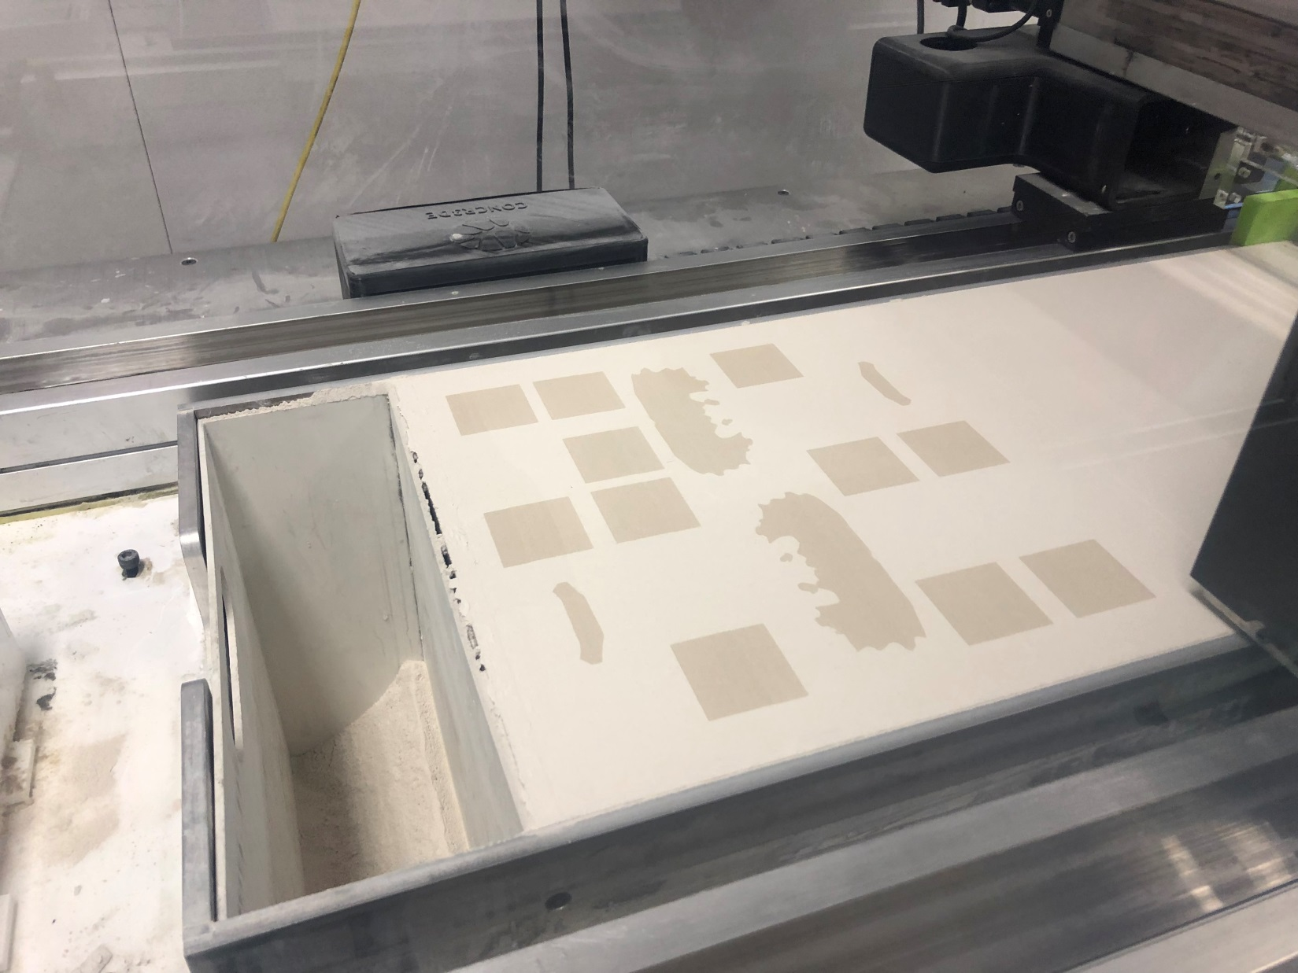
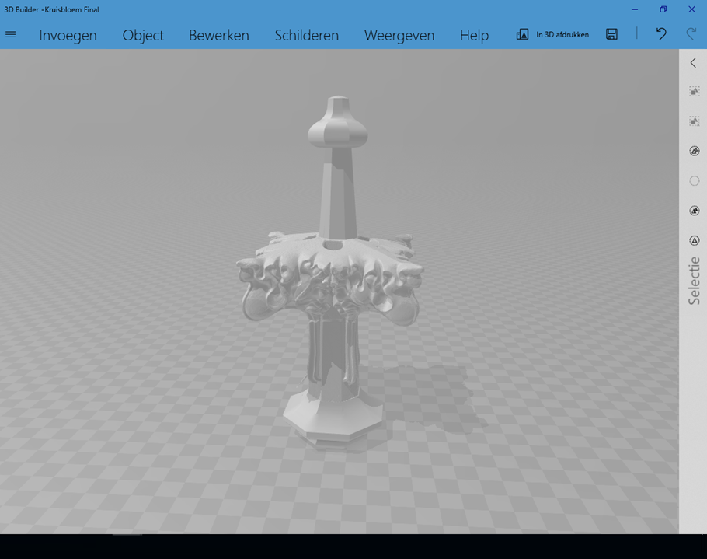
4.
ANDERE FOTO

Slide 23
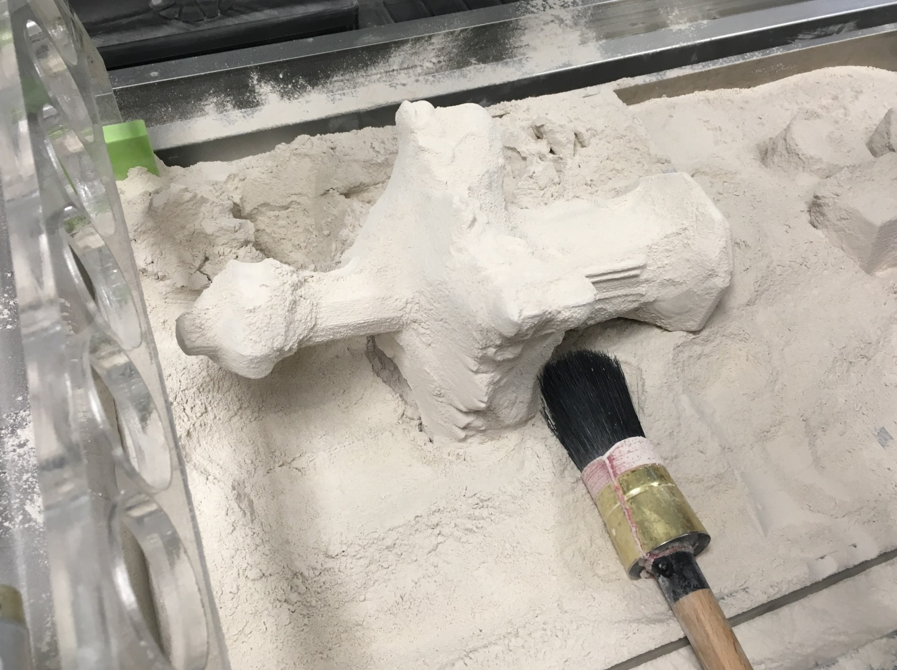

Slide 24
90% cost reduction
2 day delivery instead of 4 weeks
Custom designed material

Slide 25
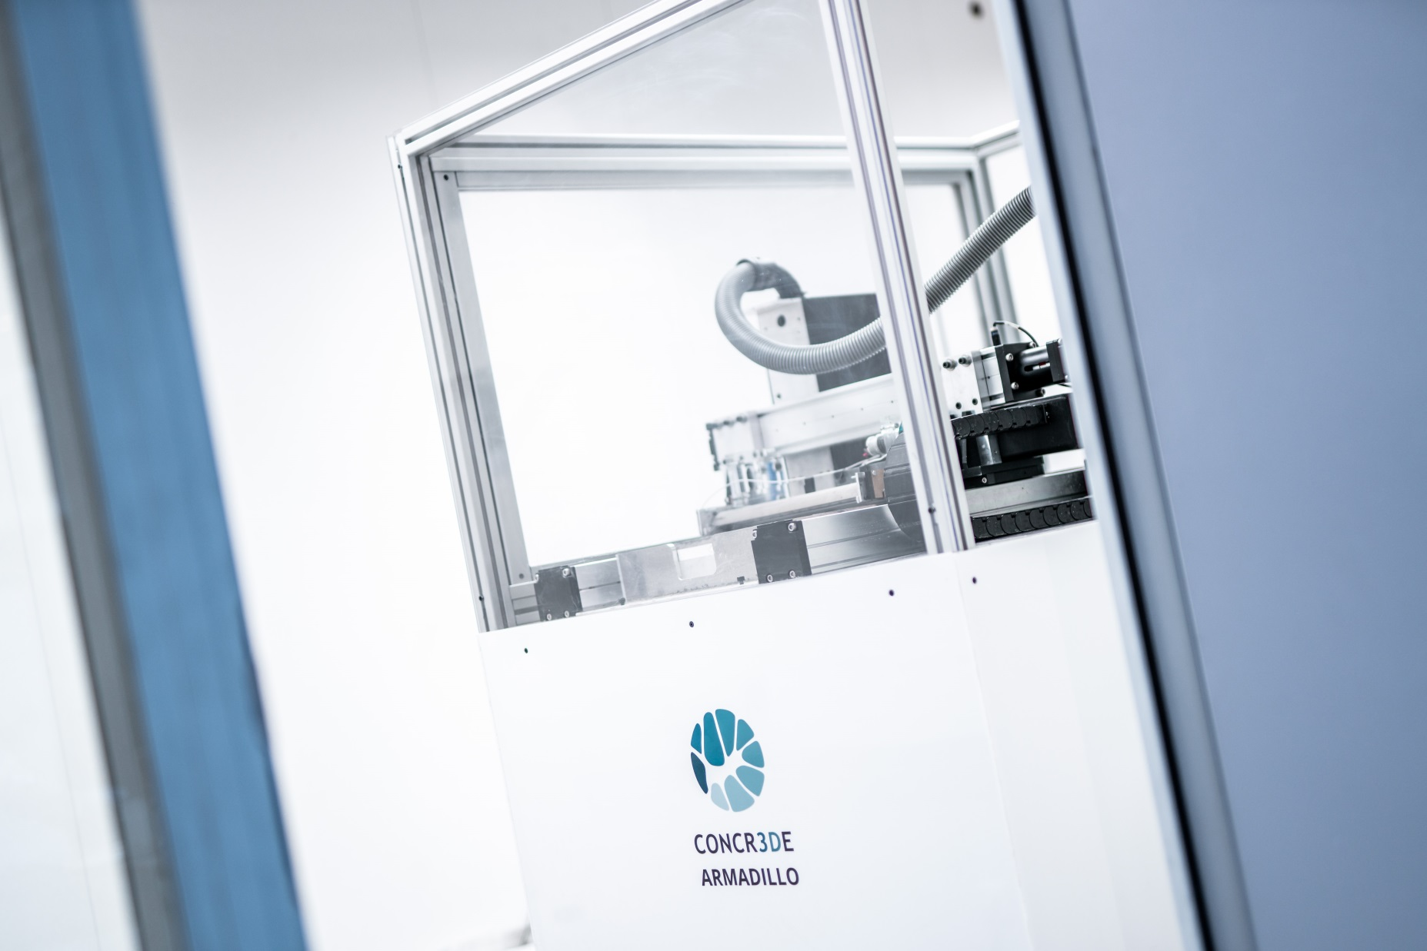
Armadillo 3D printer

Slide 26
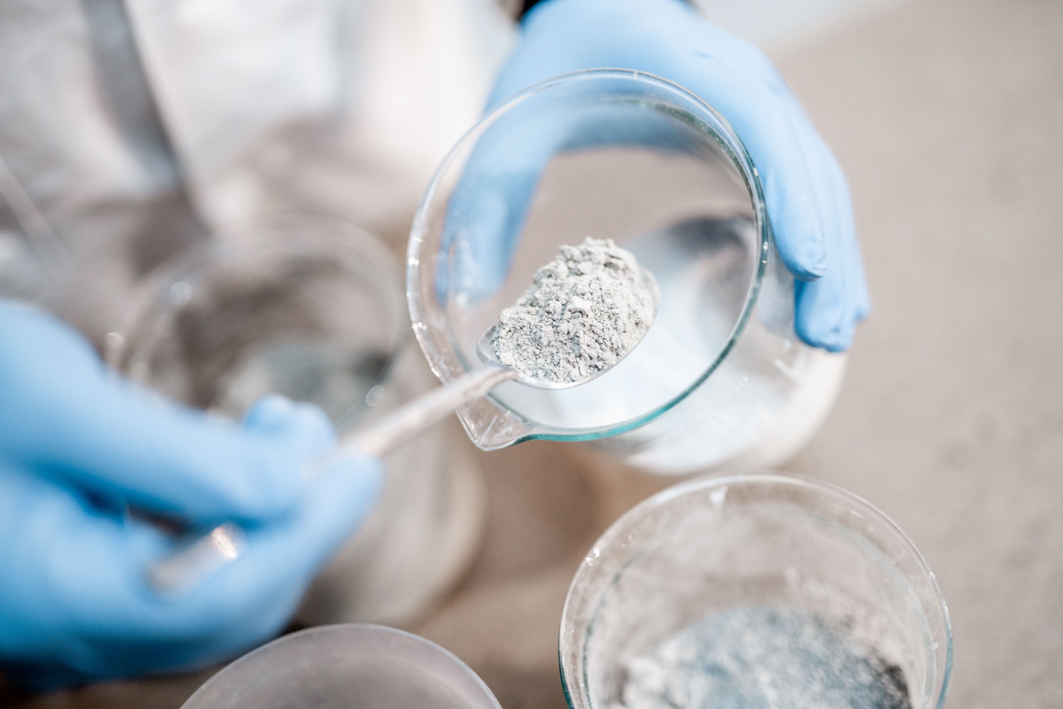
R&D.
Advanced users, researchers and educators are able to create and customize their own material systems and influence material properties.
Possibilities include cementitious materials, geopolymers, ceramics and even plastics and metals.

Slide 27
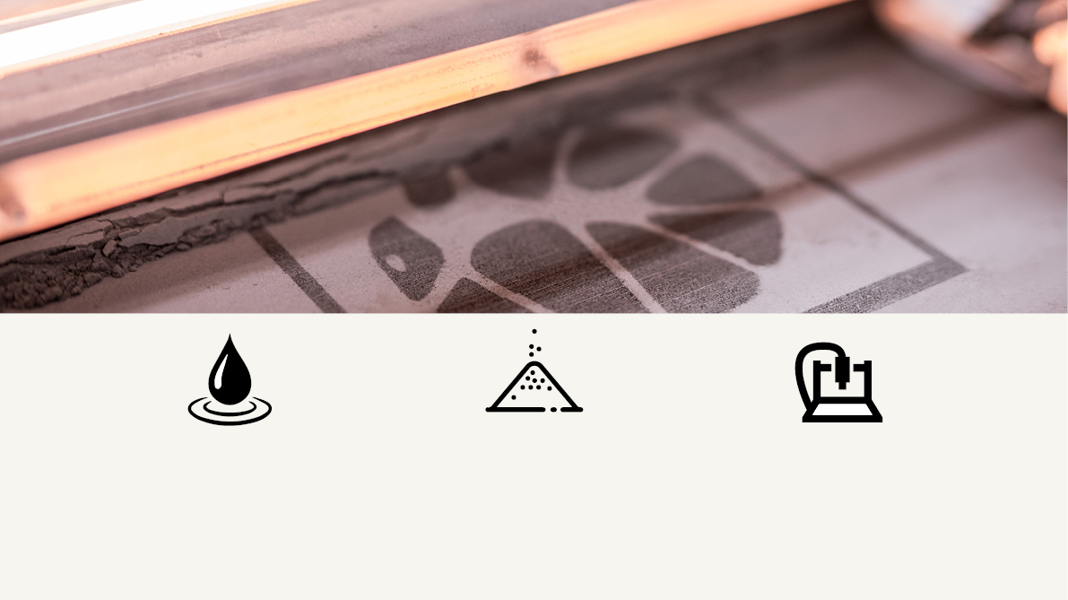
Rheology
Saturation
Precision
Stoichiometry
Composition
Granulometry
Density
Additives
Layer height
Deposition control
Environment
Post processing

Slide 28
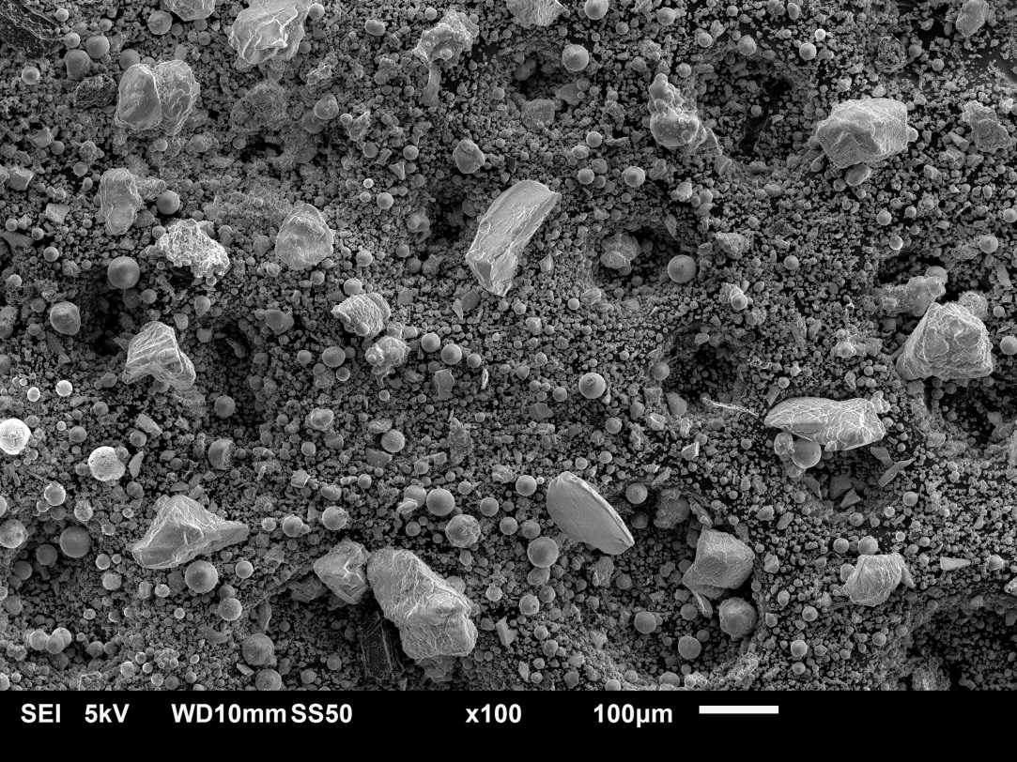
• Analysis of powder spreading on the printing bed.
• Proportions between aggregates granulometry and cementitious matrix is clearly defined and adjusted.
• Analysis of printed specimens
• Porosity and density of the final material can be tweaked changing powders parameters like granulometry and type of aggregates.

Slide 29
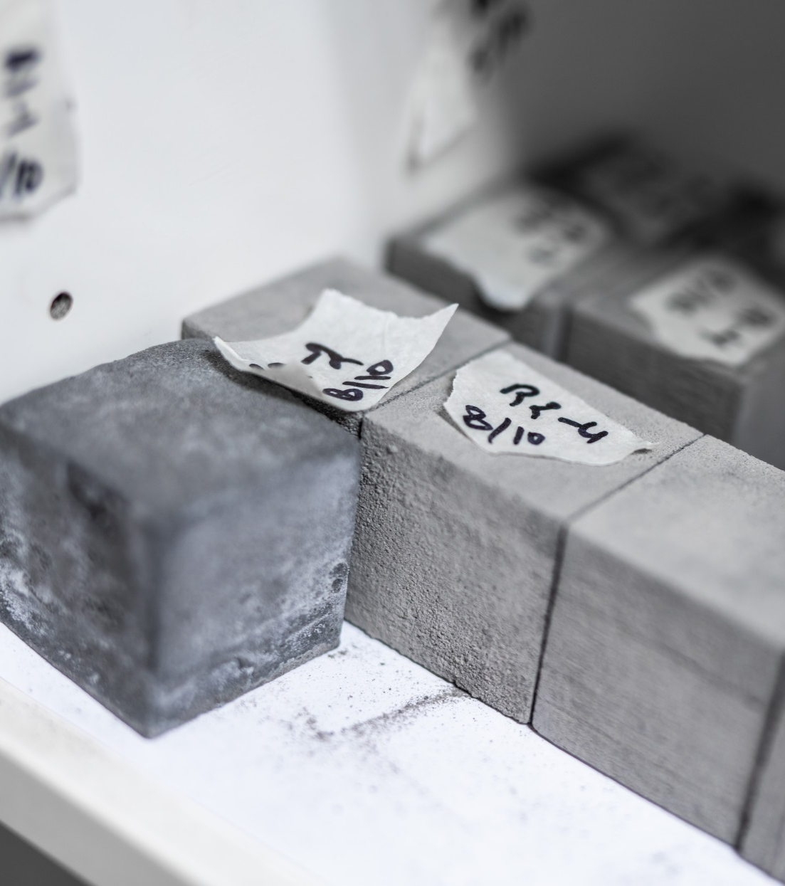
Mechanical performance & durability
• Test of different mixtures and binder ratios.
• Compressive strenght of 20-25 MPa achieved.
• Main challenge is to improve compressive
strength up to 30/40 MPa.

Slide 30
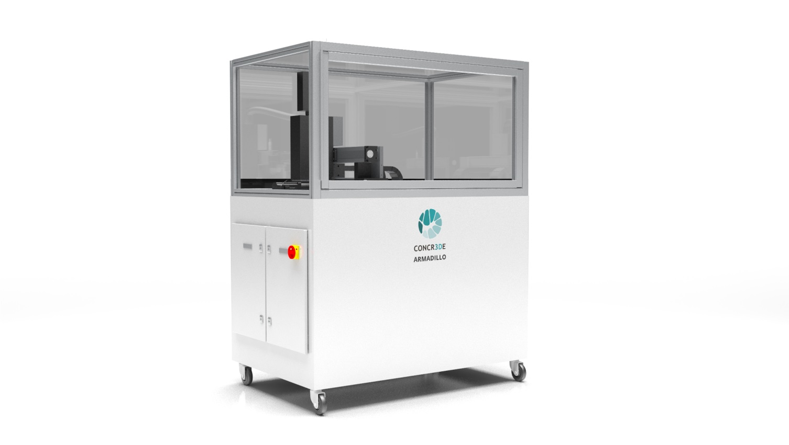
Armadillo WHITE
Research & prototyping 3D printer
Available now
Designed for research
Develop custom material systems and influence material properties with this fully accessible system
Print geopolymers, ceramics, metals, plastics and cementitious materials
Printhead precision | 400 DPI
Layer height | 40-400µ
Print dimensions | 300x300x300 mm

Slide 31
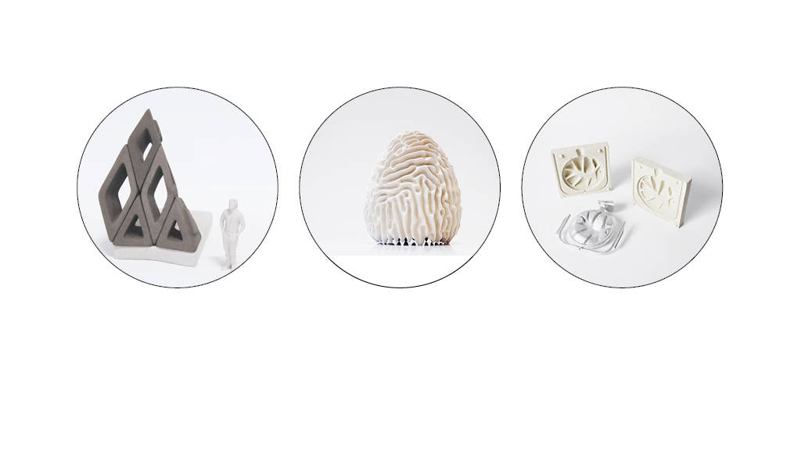
PRINTED PRODUCTS
Inorganic polymers
Cementitious materials
Ceramics

Slide 32
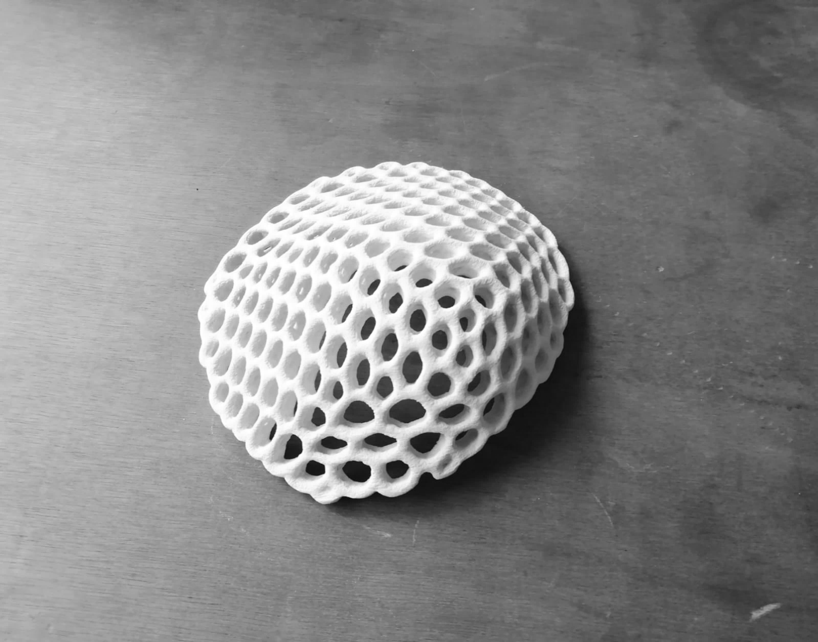
Technical ceramics (Al,Zr)
Biopolymers
Bioceramics
MCC, Metals ceramic composites
Metals

Slide 33
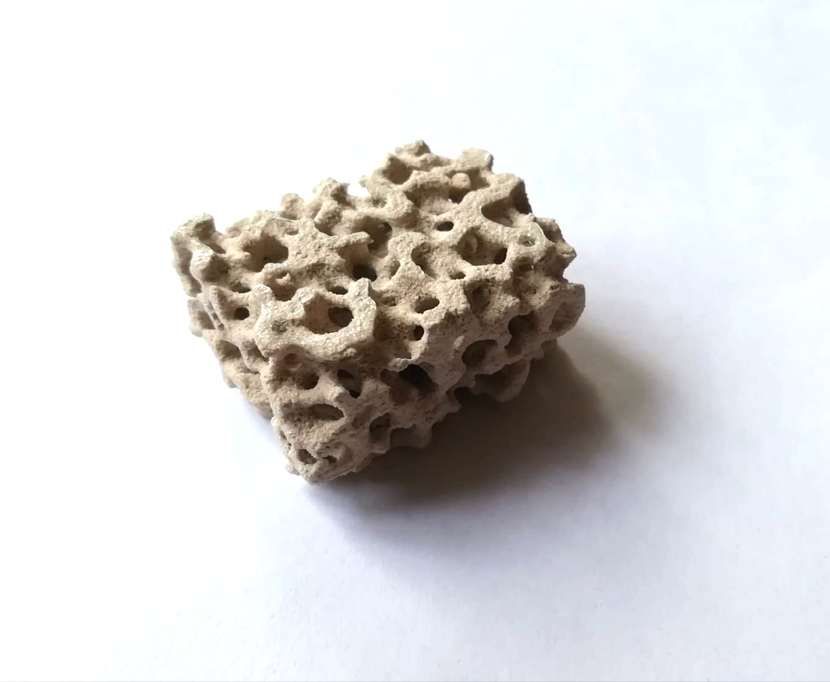
How do we collaborate?
Material codevelopment
Systems and products
We sell additive manufacturing systems.
We provide the knowledge to 3dprint and develop materials with our technology.
We offer testing services at our facilities.
We form a consortium for European calls or grants.

Slide 34
Coming up...

Slide 35
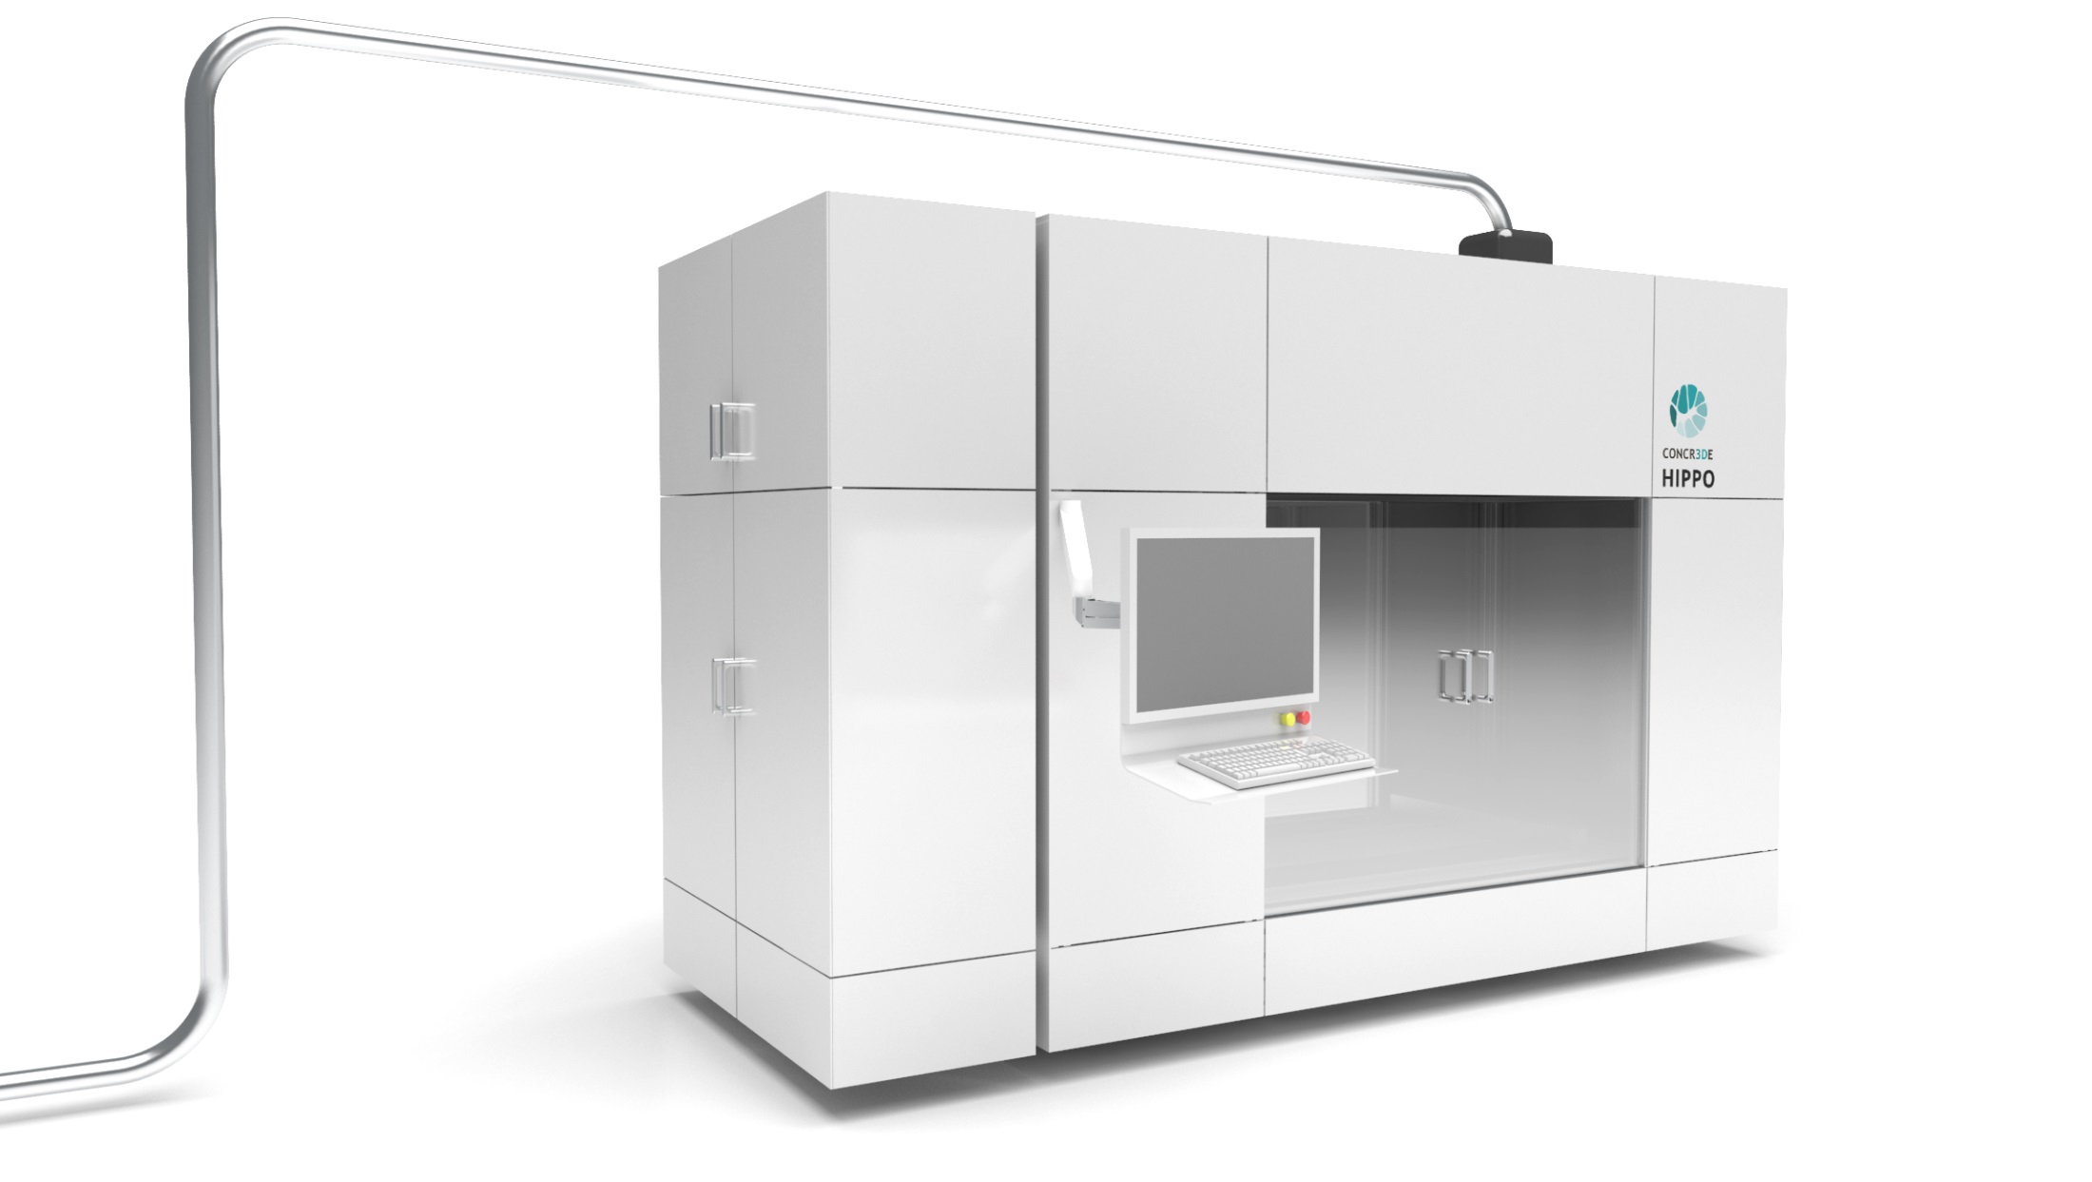
COMING UP...
HIPPO PRINT FACTORY
Fully automated CONCR3DE print factory
Print your own materials or choose from a range of validated CONCR3DE materials
Fully integrated work flow including powder handling, data processing and process monitoring
Continuous operation

Slide 36
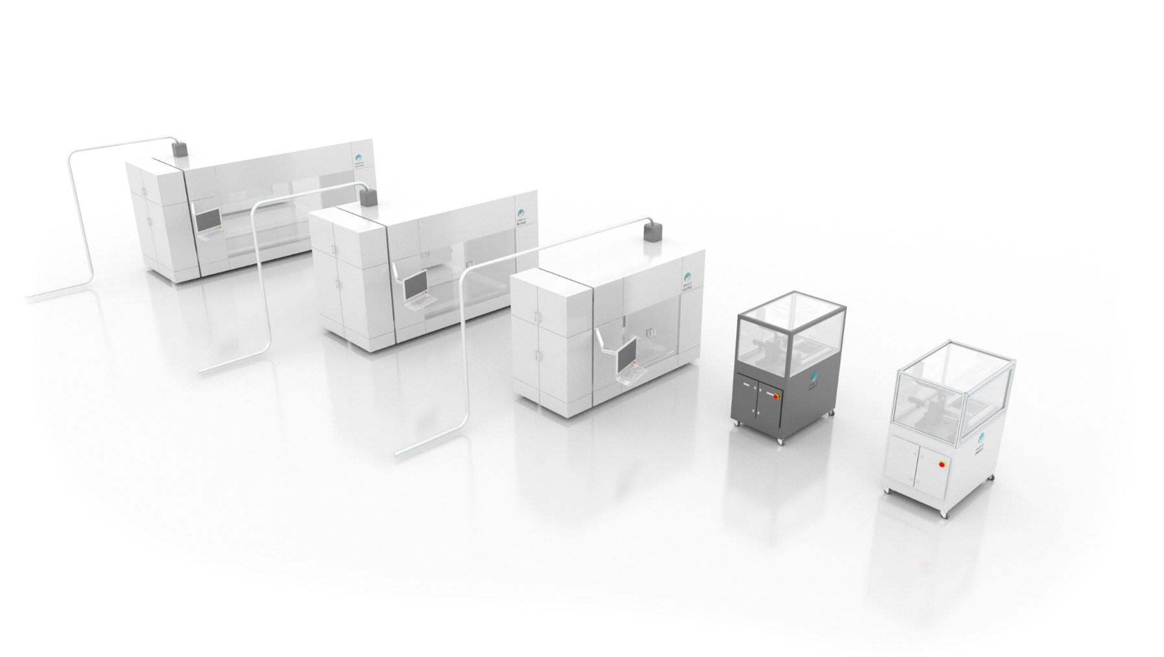

Slide 37
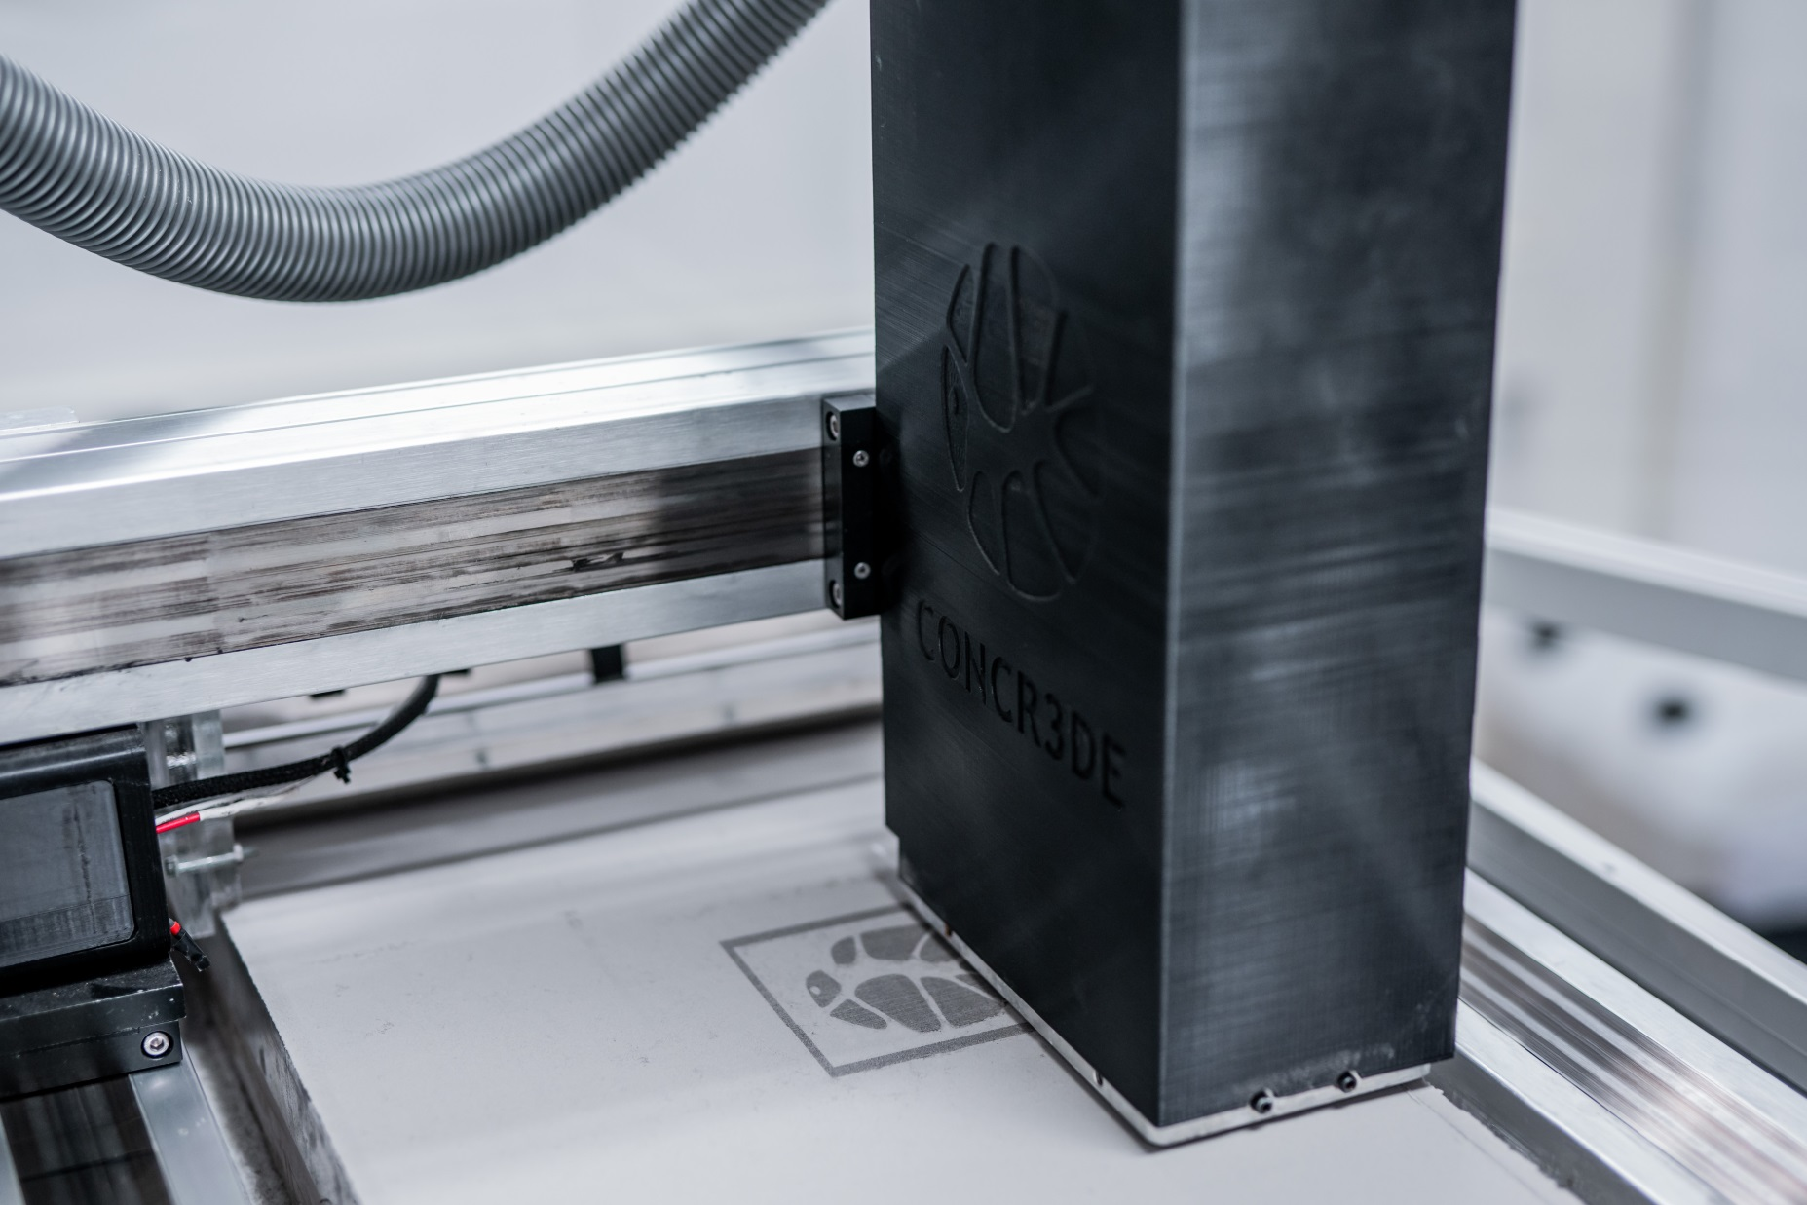

Build your own future
CONCR3DE b.v.
Scheepsbouwweg 8 A3-A4
3089JW, Rotterdam
+316 43 696 176
www.concr3de.com
@CONCR3DE

